Slide 1
Holiness

Slide 2
WHY we need to be healthy?
To be holy
To Set Apart

Slide 3
WAIT !!!

Slide 13
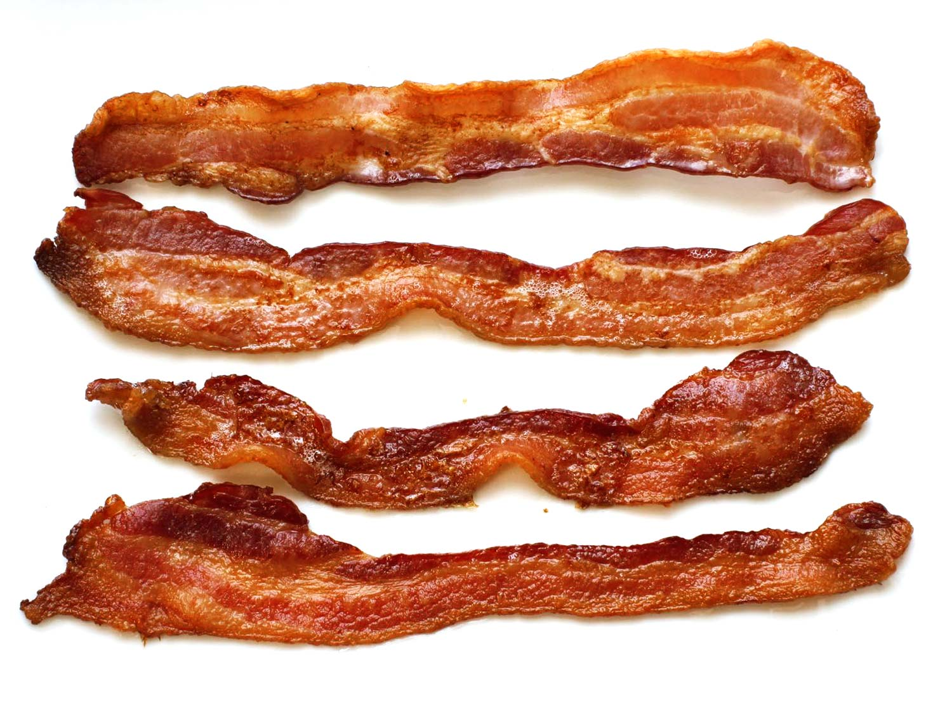

Slide 15
What is set apart?

