Slide 1
HOLINESS

Slide 14
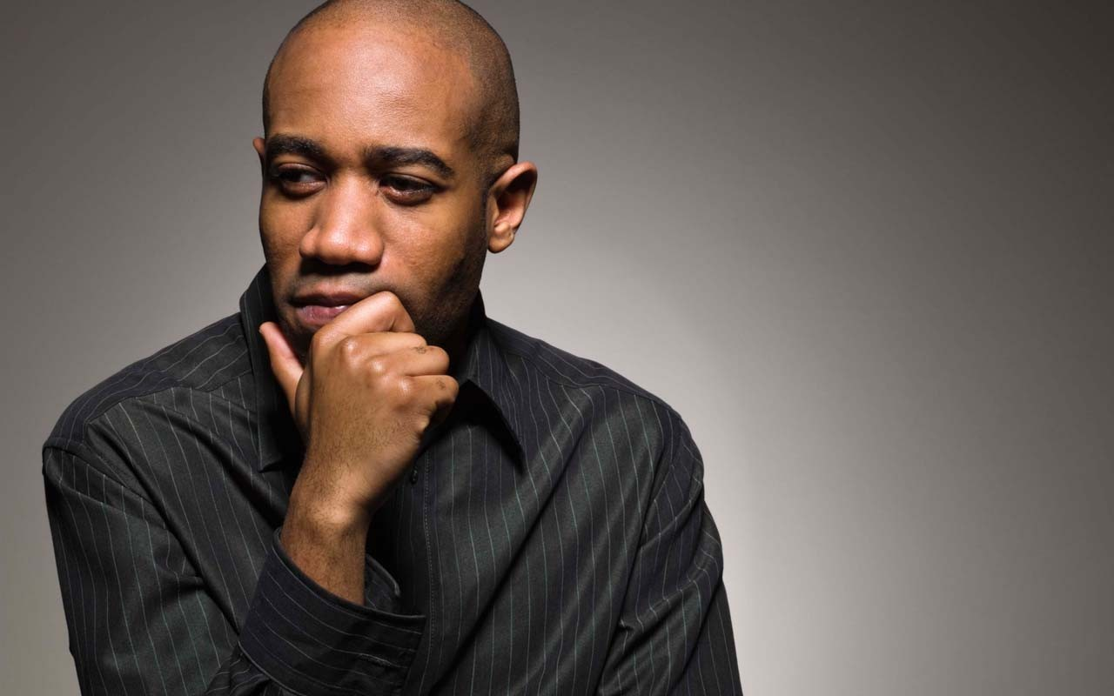
Why Temple was destroyed?

Slide 17
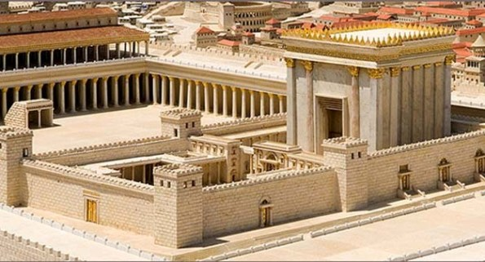

Slide 18
What is our spiritual Anti-Oxidant?

Slide 19
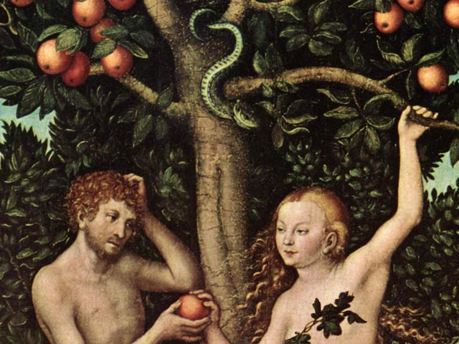

Slide 20
SEEN
UNSEEN

